Slide 1
Introduction to Kubernetes
Ashish Raj

Slide 2
What are containers
App A
App B
App C
App D
App E
App F
Containerized Apps
Bin/Lib
Bin/Lib
Bin/Lib
Bin/Lib
Bin/Lib
Bin/Lib
Docker
Host Operating System
Infrastructure
Image ref: https://www.docker.com/resources/what-container

Slide 3
Container Layers
Container Layer(Thin r/w)
Website Layer
Website Layer
ASP.NET Layer
ASP.NET Layer
IIS Layer
IIS Layer
Base OS Layer
Base OS Layer

Slide 4
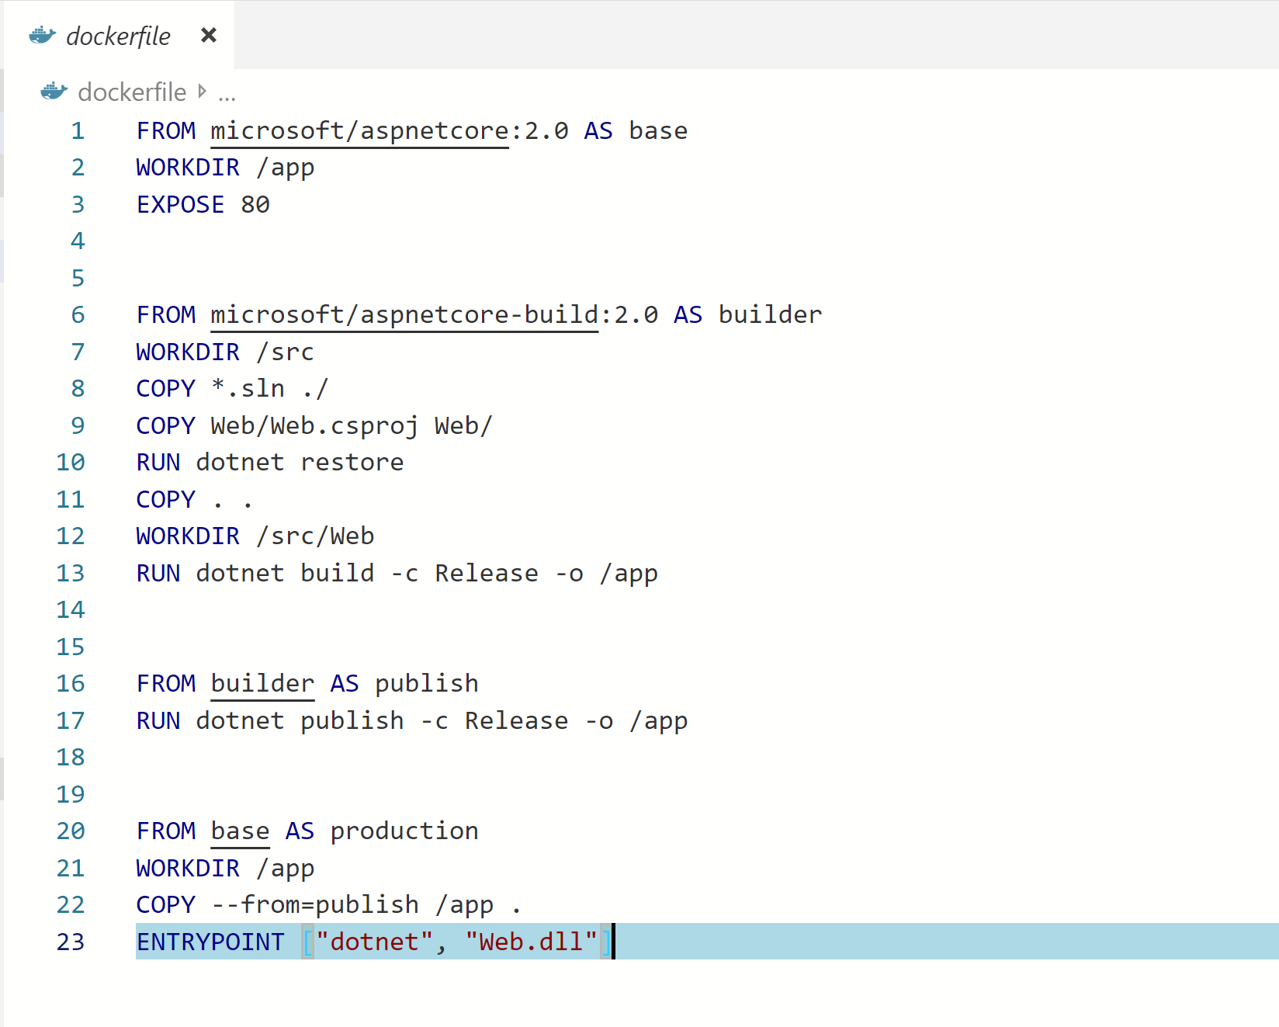
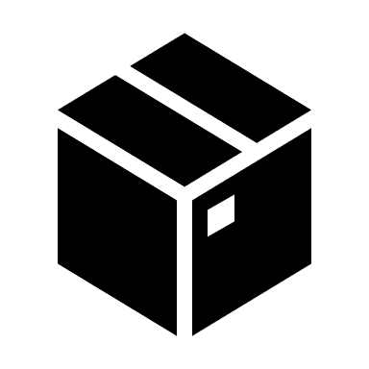

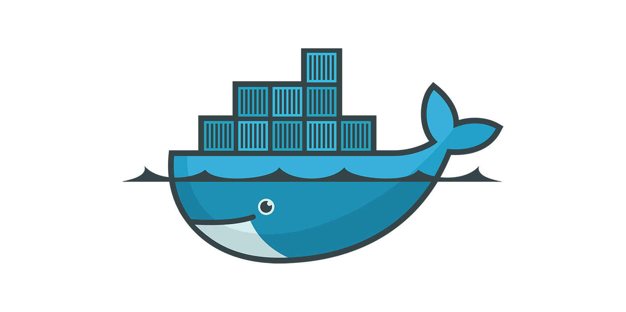
Docker build
Docker run
Docker file
Docker image
Containers

Slide 5
Why Containers
Less resource intensive
Isolation
Greater Agility
Fast Startup time
Improve Server Density

Slide 6

Next, Containers in prod!
Image ref: https://www.infoworld.com/article/3268073/what-is-kubernetes-container-orchestration-explained.html

Slide 7
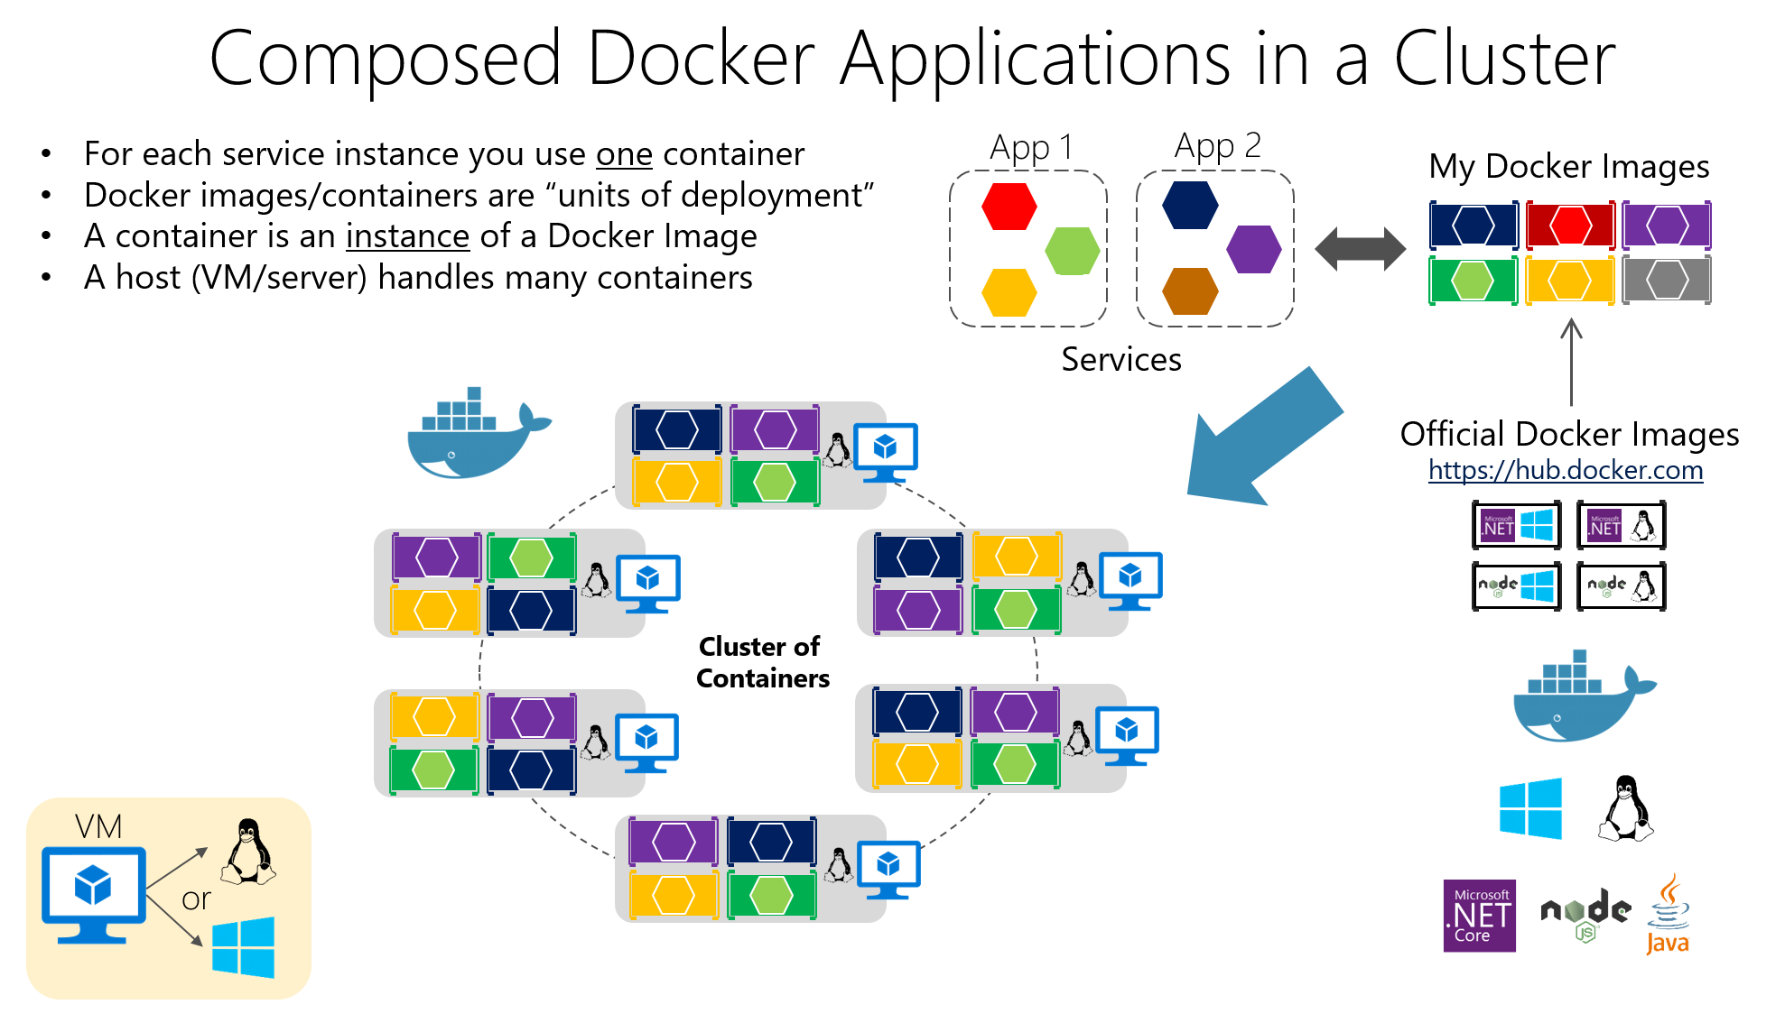
Image ref: https://docs.microsoft.com/en-us/dotnet/standard/microservices-architecture/architect-microservice-container-applications/scalable-available-multi-container-microservice-applications

Slide 8
Container Orchestration
Docker Swarm
Kubernetes
Mesosphere DC/OS
And Many more…

Slide 9
Why Kubernetes
One of the largest container orchestration with open source community support.
Inspired from Google own infrastructure Orchestrator called Borg.
Declarative approach.
Supports Service discovery.
APIs for deployment workflows.
Inherent support for cloud native architecture, microservices and DevOps.
And many more feature to run a modern Data Center based on containers.

Slide 10
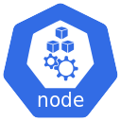
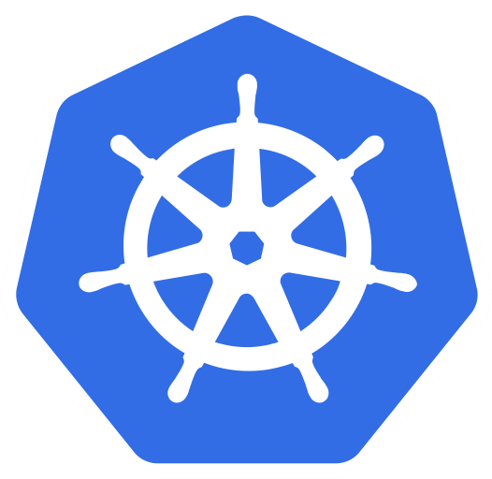

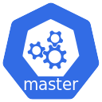
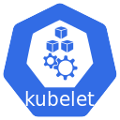
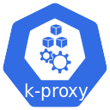



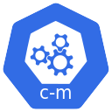

UI
CLI

Slide 11
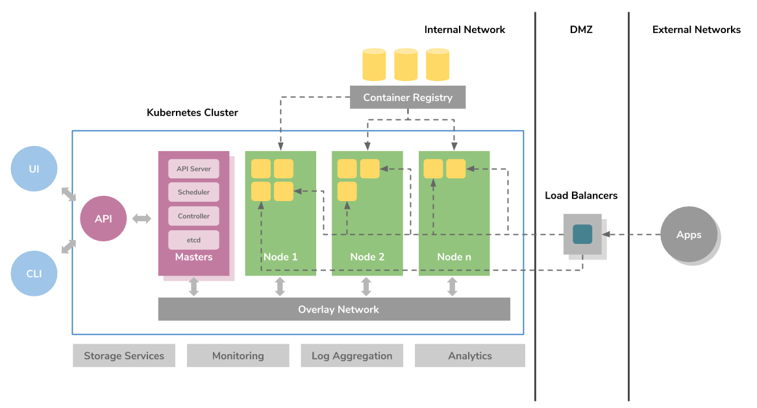
Kubernetes Architecture

Slide 12
Kubernetes Deployment
Local Kubernetes cluster using minikube. https://kubernetes.io/docs/setup/learning-environment/minikube/
Get Started with Azure Kubernetes Service (AKS) or any other Kubernetes Managed service. https://docs.microsoft.com/en-us/azure/aks/

Slide 13
Demo
Deploy AKS cluster.
Run Kubernetes deployment using kubectl on AKS cluster.
Access the deployed app.

Slide 14
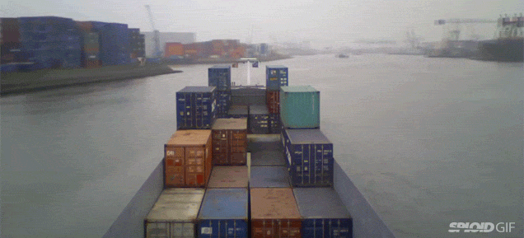
Pods
Notes:
In Kubernetes, Pods are responsible for running your containers. Every Pod holds at least one container, and controls the execution of that container.

Slide 15

ReplicaSets
Notes:
A ReplicaSet ensures that a set of identically configured Pods are running at the desired replica count.

Slide 16

Secrets
Notes:
Secrets are used to store non-public information, such as tokens, certificates, or passwords.

Slide 17

Deployments
Notes:
A Deployment is a higher-order abstraction that controls deploying and maintaining a set of Pods. Behind the scenes, it uses a ReplicaSet to keep the Pods running, but it offers sophisticated logic for deploying, updating, and scaling a set of Pods within a cluster.

Slide 18

DaemonSets
Notes:
DaemonSets provide a way to ensure that a copy of a Pod is running on every node in the cluster. As a cluster grows and shrinks, the DaemonSet spreads these specially labeled Pods across all of the nodes.

Slide 19

Ingress
Notes:
Ingresses provide a way to declare that traffic ought to be channeled from the outside of the cluster into destination points within the cluster. One single external Ingress point can accept traffic destined to many different internal services.

Slide 20

CronJobs
Notes:
CronJobs provide a method for scheduling the execution of Pods. They are excellent for running periodic tasks like backups, reports, and automated tests.

Slide 21
Deploy to Kubernetes

Slide 22
Q & A!

